Slide 1
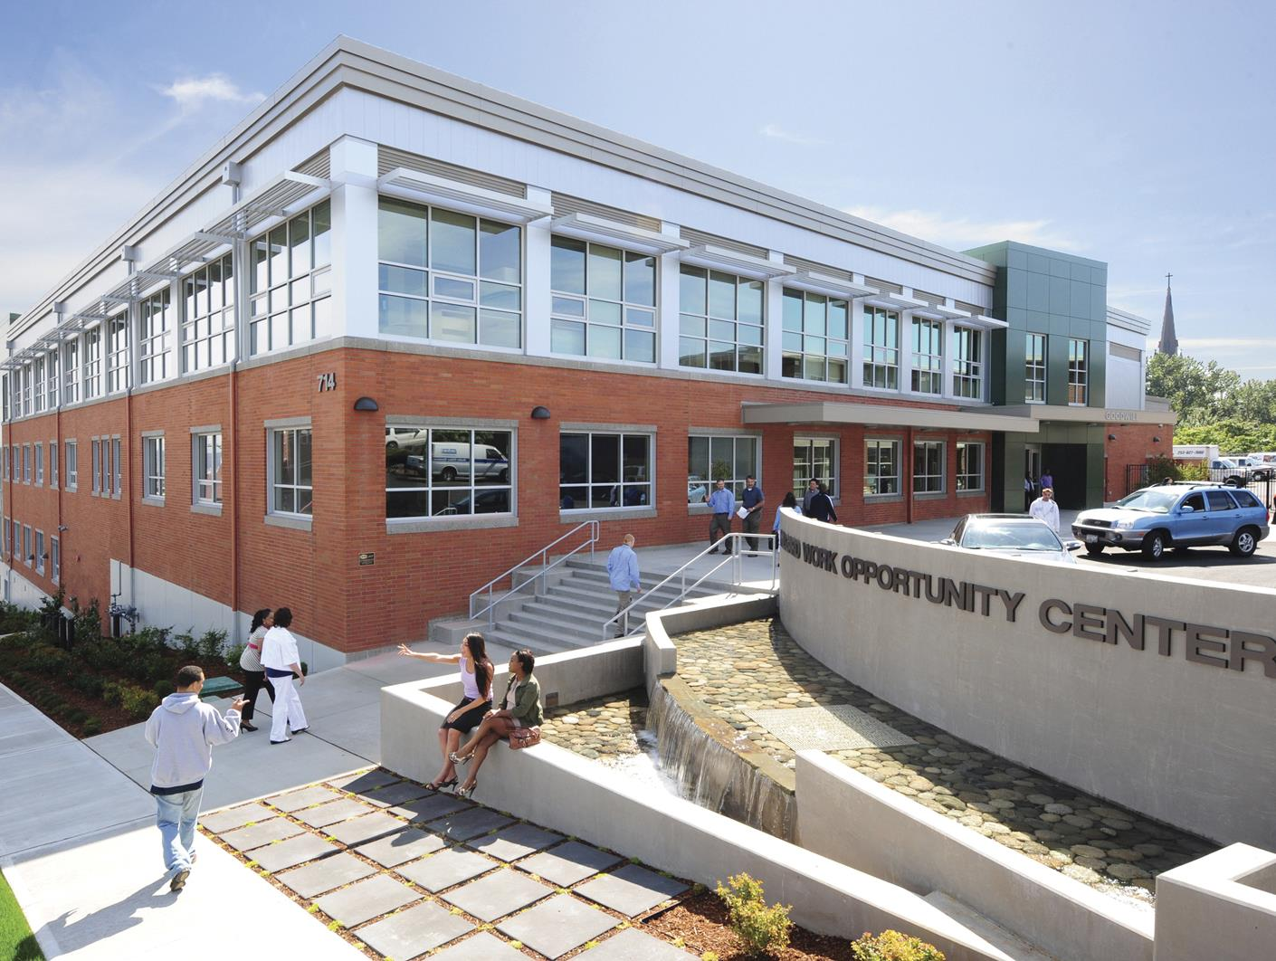

Slide 2
Goodwill of the Olympics & Rainier Region Our Vision & Mission
Our vision is that every person has the opportunity to learn, work and thrive in all aspects of life.
To achieve our vision, we are committed to dismantling racism and advancing equity, diversity and inclusion so we can help people reach their fullest potential through education, job placement and career pathway services. We do our work with great gratitude for our community donations, purchases, and partnerships that make our mission possible.
Notes:
Our program participants’ stories are as varied as their individual backgrounds but the common thread is that they each have obstacles that hold them back from getting a job and creating a better life.
(Refer to slide)
Goodwill is an accredited educational institution by the Workforce Training and Education Coordinating Board of Washington State and consistently receives the highest endorsement from the National Rehabilitation Accreditation Commission (CARF) for our job training skills.

Slide 3
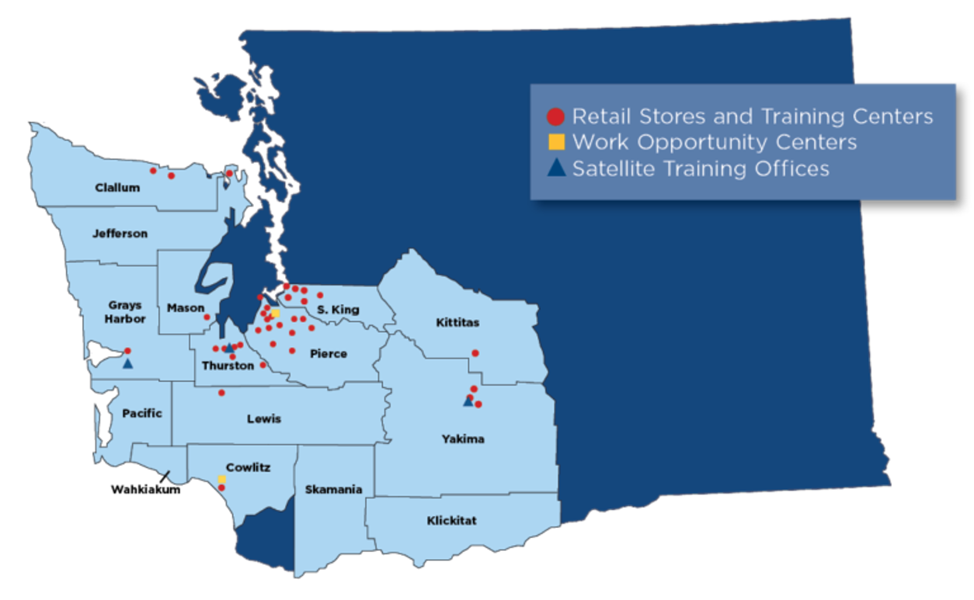
Goodwill of the Olympics & Rainier Region provides services to a 15 County region

Slide 4
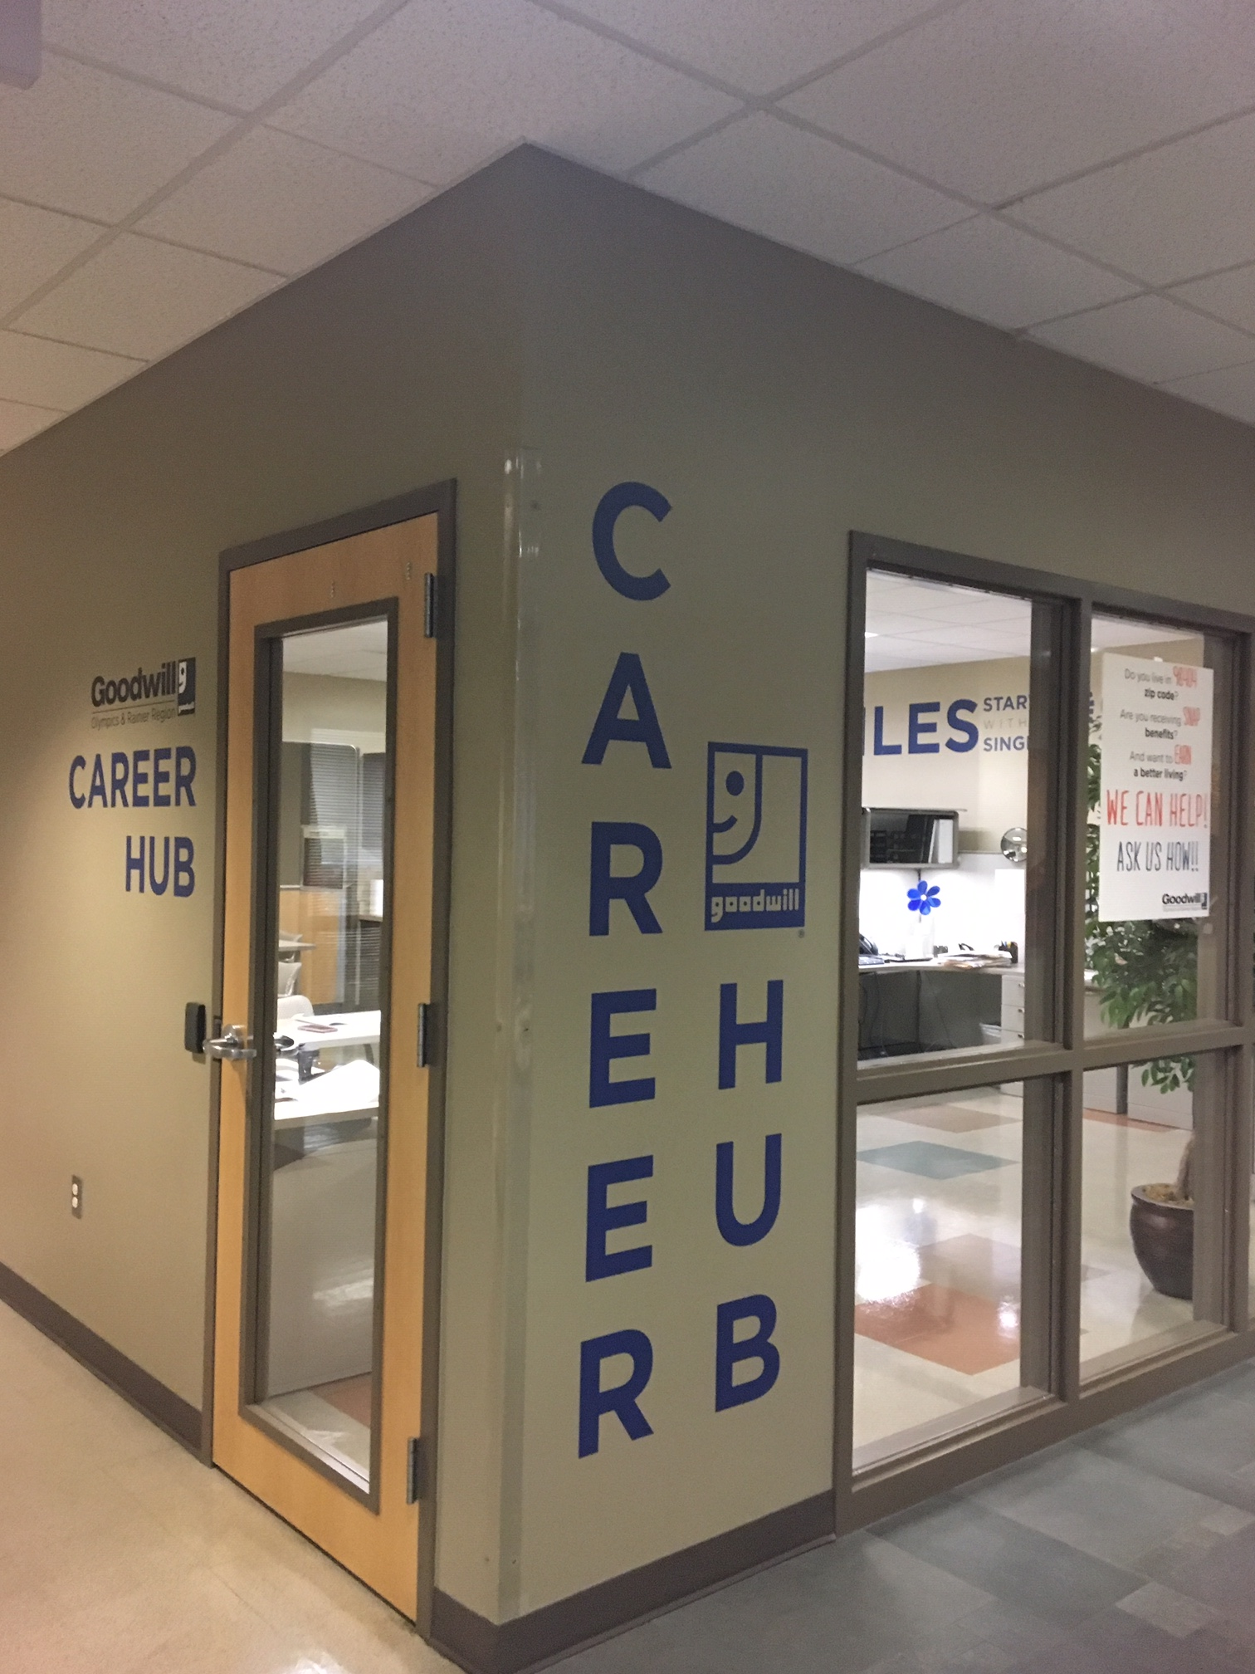
Goodwill Work Opportunity Center Career Hub
Vocational training course enrollment
Financial Opportunity Center
Student Services
Career Readiness classes
Financial Education classes
Job Resource Room
Monthly Community Newsletter: monthly spotlight, Goodwill classes & events, job leads, hiring fairs, local community resources, events, & more!
Email: CareerHub@goodwillwa.org
Phone: 253-573-6508
Subscribe to our Newsletter @ https://goodwillwa.org/career-hub

Slide 5
Goodwill Work Opportunity Center
We operate a licensed vocational school, recognized through the Workforce Training and Education Coordinating Board (WTECB), State of Washington.
Our programs are designed based on the current needs of the communities we serve, derived from local feedback, employment market surveys and other data and trends.
Monthly courses
Basic Digital Skills This class covers the basics of computer navigation necessary to find a job, take online training courses, or work towards a promotion.
Career Readiness Education & Development (CRED) Whether looking for work or wanting to advance your career, this course is a combination of important, necessary skills to be effective in finding the right job and being great at it once you get hired
Financial Education Goodwill’s Financial Education program gives the skills needed to be more confident and successful with your money, and set you on the road to financial freedom and growth.
Quarterly courses
IT Fundamentals This hybrid course prepares job seekers for entry-level employment in the tech industry as helpdesk technicians or IT technicians with a career plan. Students are introduced to core computer functions, how to manage and maintain laptops and desktops, and are introduced to the concepts around system and software applications.
Environmental Protection Training Program This hybrid course offers multiple certifications and training for entry-level positions in the environmental sciences and construction fields. Students receive 40 Hour HAZWOPER and certifications for Forklift, Flagger, and First Aid / CPR

Slide 6
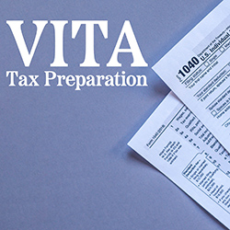
Goodwill Financial Opportunity Center
No family should struggle to make ends meet. Yet, 1 in 3 working families in Pierce County can’t afford the basics. In partnership with United Way of Pierce County and other community partners, Goodwill is able to host the Centers for Strong Families Financial Opportunity Center program and help families in need by providing the tools and resources they need to thrive. Grow it! Earn it! Keep it!

Slide 7
Goodwill Financial Opportunity Center
Financial Education
Goodwill’s FOC Financial Education course can help you gain the skills to obtain financial freedom and build a more stable future. This is a 3 week class taught in-person at our Tacoma Milgard Work Opportunity Center.
Goodwill also offers an online learn at your own pace financial education course that can be registered for by contacting our FOC office.
Financial Coaching
Every individual has a unique situation and the ability to build financial stability and self-sufficiency. Financial coaching offers the tools to help achieve financial goals and generational prosperity. Improving credit, paying off student loans, working to own a home, and planning for retirement are some of the many topics covered.
In Partnership with Tacoma Public Utilities
Tacoma Public Utility Customers enrolled in one of the two TPU Utility Assistance Programs receive a utility bill credit of $80 on their TPU bill by completing Goodwill’s FOC Financial Education course, and by also attending a financial coaching session, they receive a second credit of $80 for a total of $160!
FOC course registrations and coaching appointments: www.tinyurl.com/Goodwill-FOC
Contact us! Email: FOC@goodwillwa.org - Phone (253) 573-6750

Slide 8
Goodwill Financial Opportunity Center
VITA Free Tax Service
The Volunteer Income Tax Assistance (VITA) program is sponsored by the IRS and offers free basic tax return preparation to qualified individuals who need assistance in preparing their own tax returns.
Goodwill partners with Associated Ministries to provide free VITA Tax services at our Tacoma Goodwill Milgard Work Opportunity Center.
VITA site Facts
Staff and community volunteers at sites must pass 1 or more IRS certification exams
VITA sites have a 95% average accuracy rate while paid preparer sites (other than CPAs) have a 60% average accuracy rate.
Some sites including Goodwill assist with filing past tax returns up to 3 years back.
VITA sites can assist with:
Personal Tax Return preparation for taxpayers with incomes generally under $63,398
Basic income including W2, 1099, Military, retirement, sole-proprietor business (Uber, Lyft, etc.), most capital gains, interest & dividends, and more.
WA State Working Families Tax Credit
VITA sites cannot assist with:
Married Filing Separate returns (in Community Property States like Washington)
Complex income (large business, rental property, come kinds of capital gains)
Pierce County VITA tax site appointments: www.goodwillwa.as.me
VITA program information and National site locator tool: www.irs.gov/vita
Notes:
Goodwill’s 2023 VITA site:
312 Federal Tax returns
83 WA State Working Families Tax Credits
$463,903 in total refunds
$46,781 in tax preparation dollars saved

Slide 9
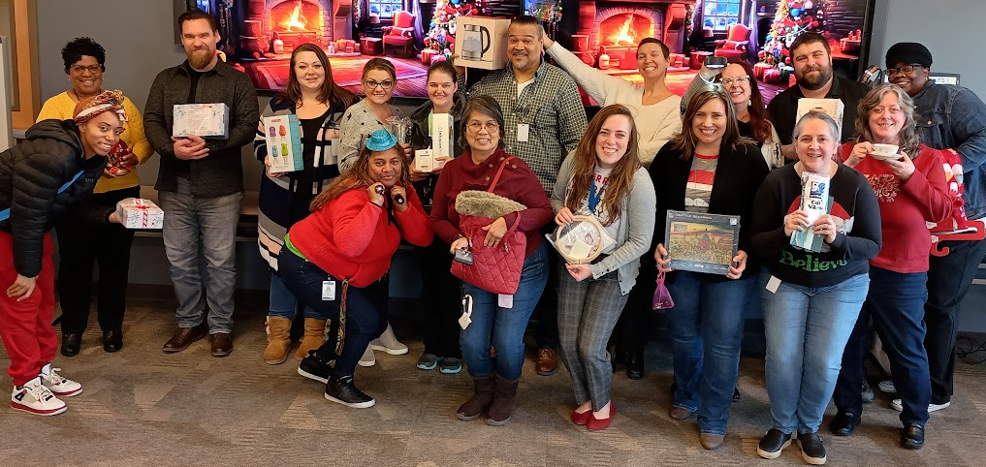
Goodwill Work Opportunity Center Vocational & Career Hub Team!
Career Hub
Email: CareerHub@goodwillwa.org
Phone: 253-573-6508
Financial Opportunity Center
Email: FOC@goodwillwa.org
Phone: 253-573-6750

Slide 10
Find all Goodwill current program Flyers at www.tinyurl.com/GoodwillFlyers
Visit our website & sign up for the Goodwill Career Hub monthly newsletter at www.goodwillwa.org/career-hub

